Slide 1

Blog Website with Database
Mini Project (KCS-752)
Submitted to:
Neha Singh
By:
Akashdeep Soni (1816410036)
Abhishek Omar (1816410016)
Branch and Section: CS-4B

Slide 2

Blog Website with Database

Slide 3
Table of Contents
Introduction
Technology Used
Hardware and Software Used
Benefits
Project
Snapshots
Flow Chart
Applications
Conclusion
References

Slide 4
Introduction
A blog is basically a website which is used for chronological listing of blog posts.
Blog website will motivate people to write ideas, confession or anything they want to express
The idea is to build a public blog website using latest technology and tools.
This website provide the functionality to compose blogs, read blogs and delete the blogs at the same time.

Slide 5
Technology Used
Web Technology
Web Technology refers to the various tools and techniques that are utilized in the process of communication between different types of devices over the internet. A web browser is used to access web pages.
Web browsers can be defined as programs that display text, data, pictures, animation, and video on the Internet.
It will have all the CRUD operations using MongoDB database and Nodejs REST API.

Slide 6
Technology Used (Cont...)
Frontend
HTML,CSS,Javascript
EJS (Dynamic Pages)
Backend
Node.js
Express.js (Framework)
Database
MongoDB
Mongoose (ODM)

Slide 7
Hardware and Software Used
Hardware used
Processor: i3 or better
RAM: 2GB or more
Storage: 2GB or more
Software used
Editor: Visual Studio Code
Browser: Chrome or Firefox
Version Control: Git

Slide 8
Blog Website with Database
Task
To provide a website where anybody can compose a blog anonymously and anybody can read it.
We will also provide the functionality to delete blogs.
Constraint
There is no account registration hence the blog is public and anybody can read or delete blog.

Slide 9
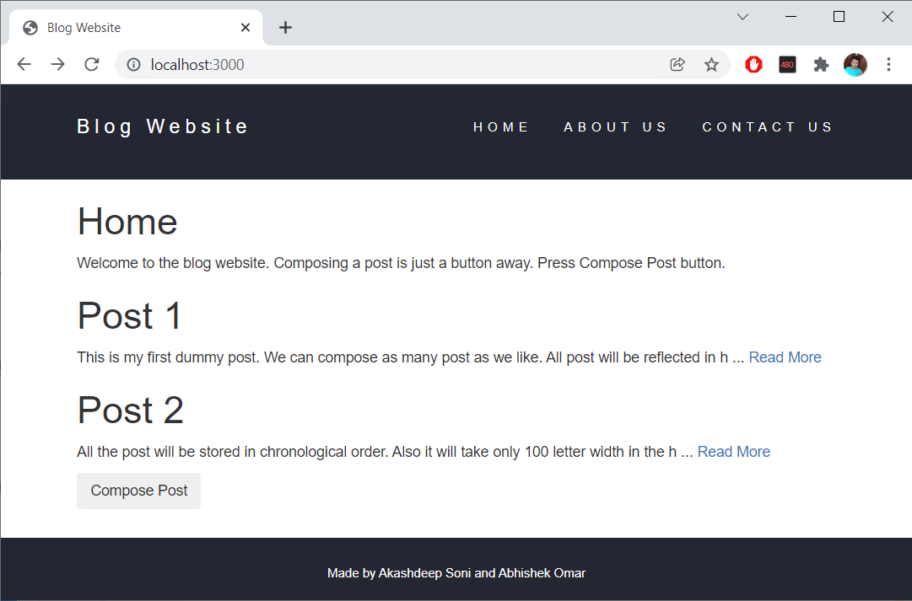
Snapshots

Slide 10
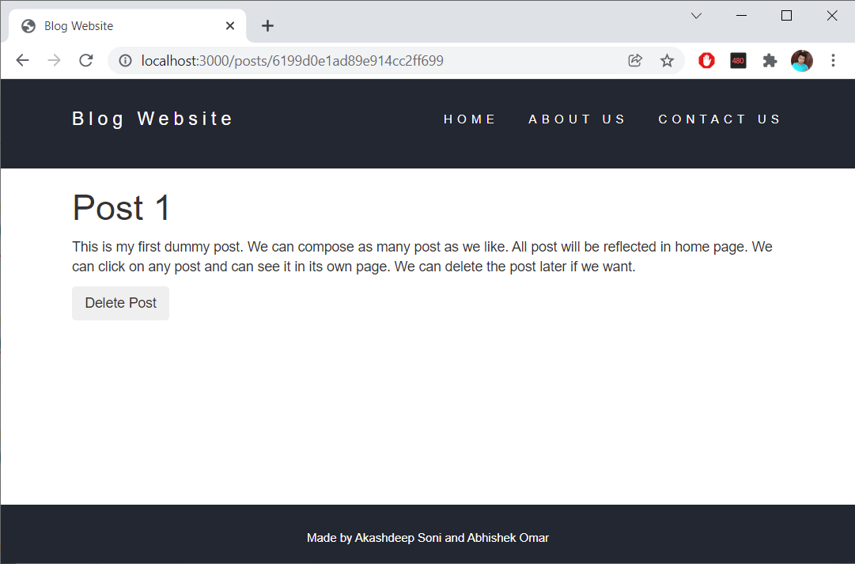
Snapshots (Cont...)

Slide 11
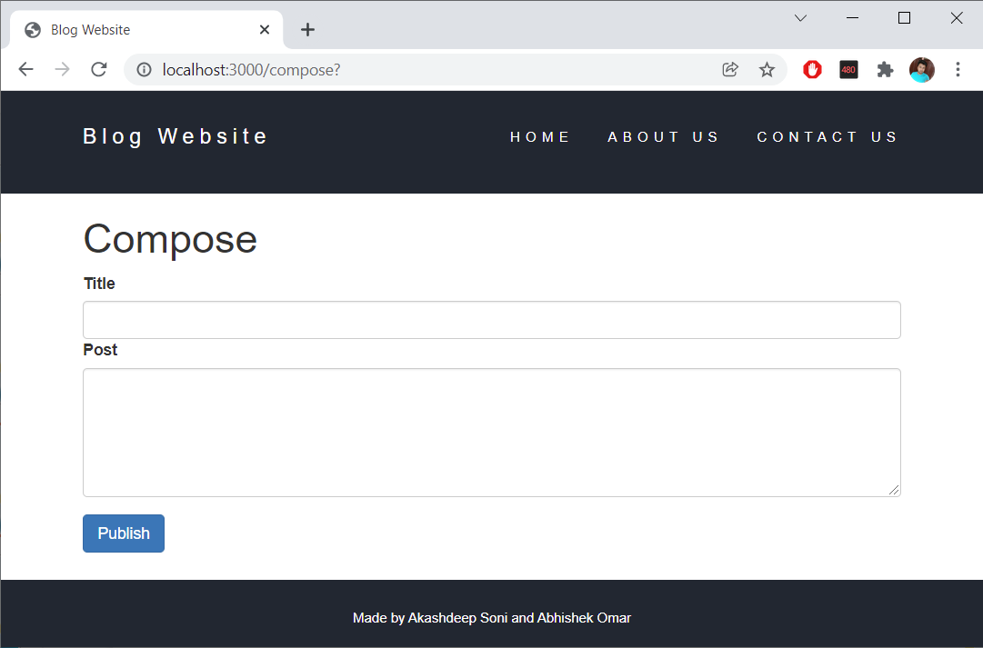
Snapshots (Cont...)

Slide 12
Flowchart
Start
Home
Homepage
Home
Read or
Compose ?
Read
Read
Compose
Compose
Post
End

Slide 13
Benefits of Blog Website
Freedom to write
Blogs are reflection of writer’s thoughts. The writer can express themselve freely. It attracts relevent people to the website.
Use as Diary
The blogs appear in chronological order so we can update daily events as a story on blog website.
Connect with Others
Readers can comment their opinion on the respective blogs hence we get the feedback from others. We can also interect with them.

Slide 14
Applications of Blog Website
Advertisement
We can show advertisement on our blog website inorder to redirect the audience to any sales website and make them buy product and services
Marketing
Marketers can use blog websites to promote and sell their products. They can do reviews of their latest products and services on the website.
Share Knowledge
Blog website can be run by anyone so it gives the freedom to share the knowledge in whatever topic he or she want to.

Slide 15
Conclusion
A blog is a frequently updated online personal journal or diary. It is a place to express yourself to the world.
A place to share your thoughts and your passions. Really, it’s anything you want it to be.
For our purposes we’ll say that a blog is your own website that you are going to update on an ongoing basis.

Slide 16
References
MDN Web Docs
https://developer.mozilla.org/en-US/
W3Schools Online Web Tutorials
https://www.w3schools.com/
The Complete 2022 Web Development
https://www.udemy.com/course/the-complete-web-development-bootcamp/
Burdman, Jessica, “Collaborative Web Development” Addison Wesley
Xavier, C, “ Web Technology and Design” , New Age International
Github Link
https://github.com/Akashdeep-Soni/blog-website-with-database

Slide 17
Thank You

